Slide 1



Concept Design Review
Track Tech: Combined GPS and Intensity-based Alignment of Laser Devices
Dawson Burgess, Spencer Butler, Marissa Samayoa
Notes:
Ill do the introduction - Dawson

Slide 2
Table of Contents
Objective
Risk Identification
Value Proposition
Recommendations/Justifications
Background
Project Schedule
Product Requirements
Budget Breakdown
Conceptual Development
Physical Demonstration
Validation Plan
Notes:
-Dawson

Slide 3
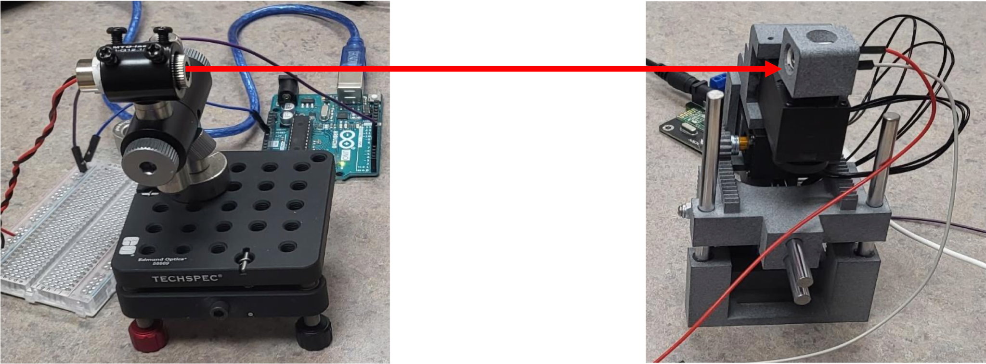
Objective
To implement and test embedded software to drive a robotic arm for optical beam alignment between two devices.
We will be implementing the rough alignment software that will then utilize the minor adjustment software that was created in last year’s capstone.
Notes:
-Dawson

Slide 4

Value Proposition
Optical transfer allows for far greater transfer capacity than using electricity.
It can be implemented in a cost effective, yet environmentally friendly way via lasers.
Laser data transfer requires very precise alignment between two devices, and often takes hours of labor to establish a single connection.
We will design software which utilizes GPS that enables the devices to align and form a connection with a single button press.
Notes:
-Dawson

Slide 5
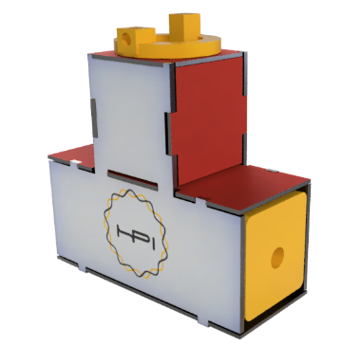
Real World Application
Our work will make contributions towards the Hansen Photonics Axon device.
The Axon device will enable the copying, multiplexing, and demultiplexing of optical signals at light speed and low cost.
This will ultimately lead to alternative cost effective solutions for server setups.
Notes:
-Marissa

Slide 6
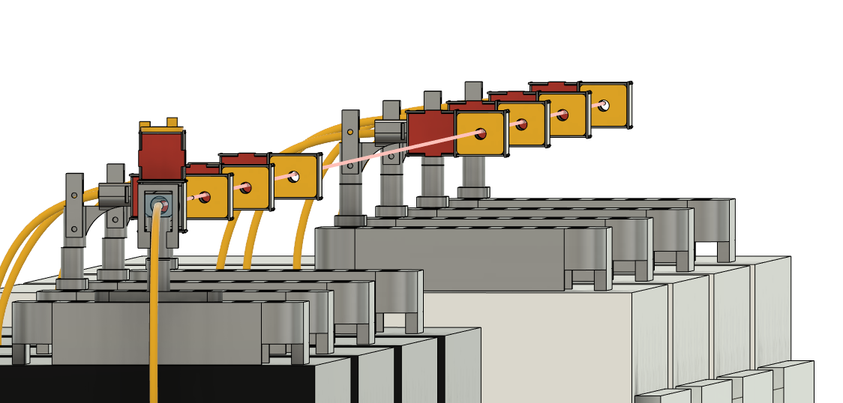


Background - Laser Data Transfer
Fiber and network cables are fast and secure, but often expensive, and require physical connections.
Wifi has no cables and can be fast, but struggles with security vulnerabilities and has a hard cap on transfer speeds.
Our technology will look to take the best of both implementations without their drawbacks.
Notes:
-Marissa
Wifi
Omni directional - can get the same benefits without using up frequency bands

Slide 7
Background - Hansen Photonics
Hansen Photonics Incorporated is a small, family company located in Burien, Washington.
They contribute to the computer networking industry with patents that cover modular networking hardware devices and systems.
HPI works with universities, environmental science centers, and small businesses to help provide new, cutting-edge hardware solutions for everyone.
Notes:
-Marissa

Slide 8
Product Requirements
01
This alignment process shall work at a minimum distance of 6 feet.
02
After beginning the program, the alignment process shall be fully automatic.
03
The devices shall weigh fewer than 10 lbs each.
04
The program shall be written in a modular style.
Notes:
-Marissa

Slide 9
Conceptual Development
The process our code and design will go through every time it operates:
Acquiring positional data of laser and servo arm
GPS module + accelerometer
Communication Between boards
Wifi vs wired
Code for the alignment process
3
1
2
75%
4
Get positional data
Boards communicate positions
Code for alignment process is executed
Maintain optimal signal strength
Notes:
Spencer

Slide 10

Conceptual Development
Currently, the existing code carries out the following tasks:
Scan for a signal using a spiral pattern.
When a valid signal is found, find the bounds of the signal area in X, Y, and R.
Set final position to location with highest input voltage.
Our designs will make use of this algorithm for fine adjustments and optimal signal strength.
Notes:
Spencer

Slide 11
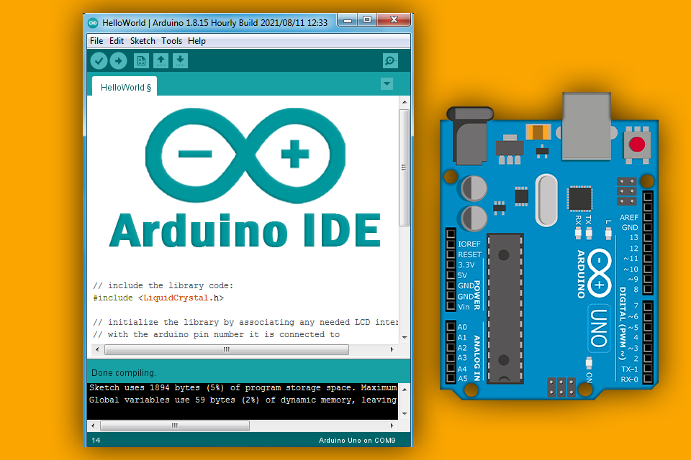
Conceptual Development
For this project the follow information is relevant:
Programming languages:
We will be using the Arduino C programming language, as it is what the boards will run.
This is C like in nature, with some small adjustments (loop and setup functions)
Environment:
The coding environment we will use is the Arduino IDE, which is pretty typical for any arduino project.
We will be using either the Arduino IDE or Visual Studio Code for I/O.
Notes:
Spencer

Slide 12
Validation Plan
Requirement
Test
Weight
Weigh Devices, devices shall not exceed 10 lbs
Code compiles and runs
Compile code and flash to board
Connection at 6 feet
Set devices 6 feet apart and run program
Connection from 45 degrees
Rotate receiver 45 degrees off-axis and run program
Connection from 90 degrees
Rotate receiver 90 degrees off-axis and run program
Connection from 180 degrees
Rotate receiver 180 degrees off-axis and run program
Notes:
Spencer

Slide 13

Risk Identification
Failure of parts
Issues with arduino boards
Possible faulty components
Parts easily break
Bugs in code
Hardware Inexperience
Wiring
Micro-controllers
Notes:
-Dawson

Slide 14
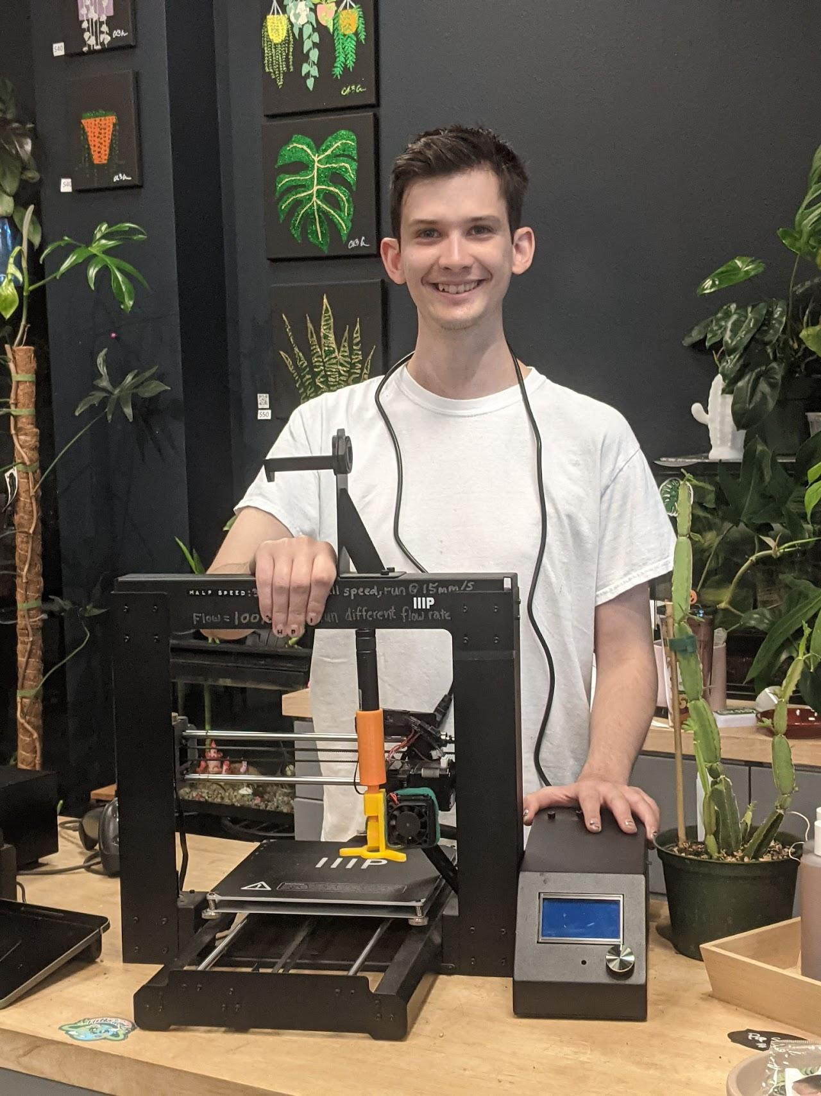
Recommendations/Justifications
Meet our client - JP Hansen. He designed the robot for this capstone project and the previous iteration.
JP has suggested that we install GPS modules and accelerometers into the devices in order to implement this rough adjustment software.
Since he has experience and knowledge about this technology, we have decided to take his advice for our plan.
Notes:
-Marissa

Slide 15
Project Schedule
Oct
Nov
Dec
Jan
Feb
Mar - May
Developing a plan
Testing of previous work
Development of code
Implementation
Feedback and Adjustments
Project Close
Sourcing documents vital to project:
Project Plan (DVP, Budget, Project Schedule)
Acquiring and testing of previous designs and code.
Starting code design process for our algorithm.
Developing the code necessary to carry out tasks.
Installing all the new parts, getting the code to compile and run properly.
Sharing our work with our client, receiving feedback for final changes.
Finishing out the project with final documents and presentations.
Notes:
-Marissa

Slide 16
Budget Breakdown
$300 Total
04
04
01 GPS Modules
04 Connectors
Estimated Amount: $100
03
Estimated Amount: $50
01
03
01
02 Accelerometers
03 Possible Arduino Board
02
Estimated Amount: $100
Estimated Amount: $50
Notes:
-Marissa

Slide 17
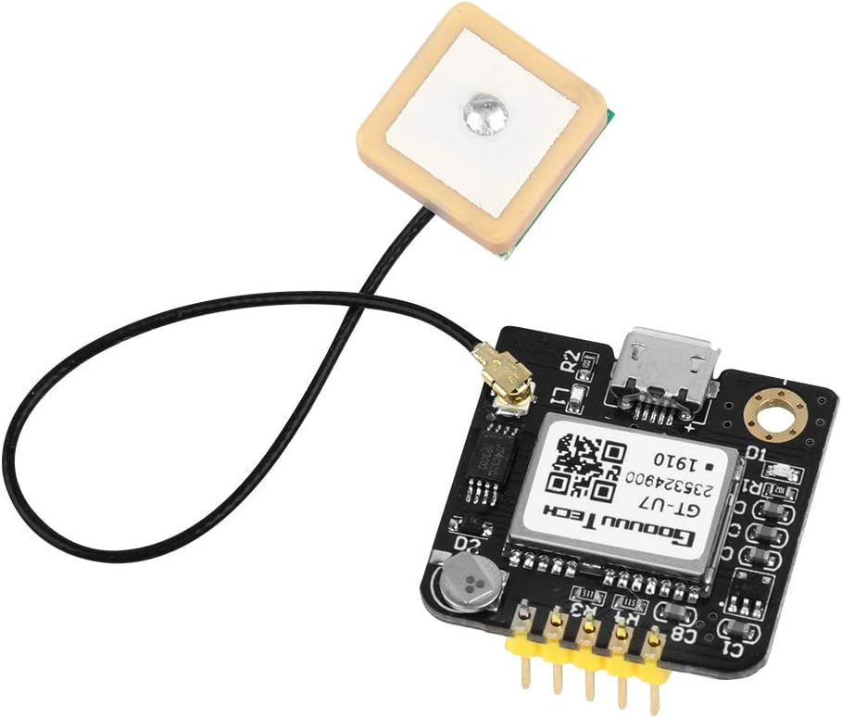
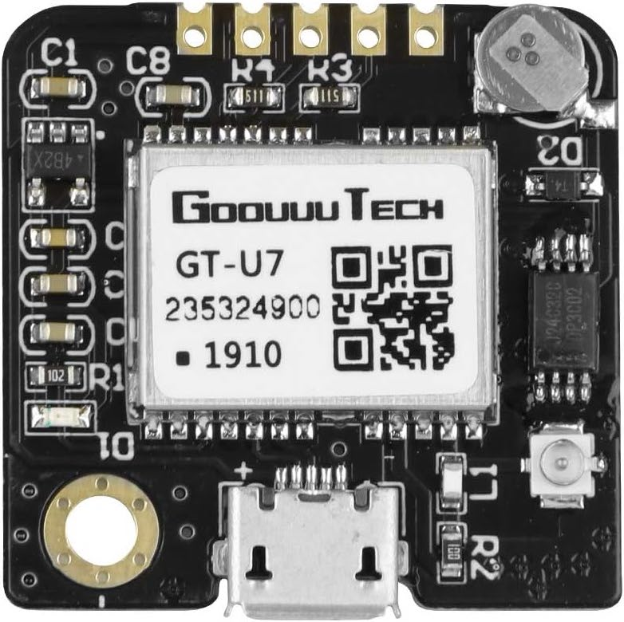
GPS Modules
We will need two GPS modules:
For the laser pointer to gather data about it's position/where it's pointing.
For the servo arm that moves to align it’s position with the laser for optimal strength.
For this project, our needs will be met from this GT-U7 GPS module.
It comes in a two pack.
Operates with a low power consumption.
It is also compatible with NEO-6M (soft requirement from JP)
Notes:
-Dawson
a well-performing complete GPS receiver with a built-in 25 x 25 x 4mm ceramic antenna, which provides a strong satellite search capability.

Slide 18
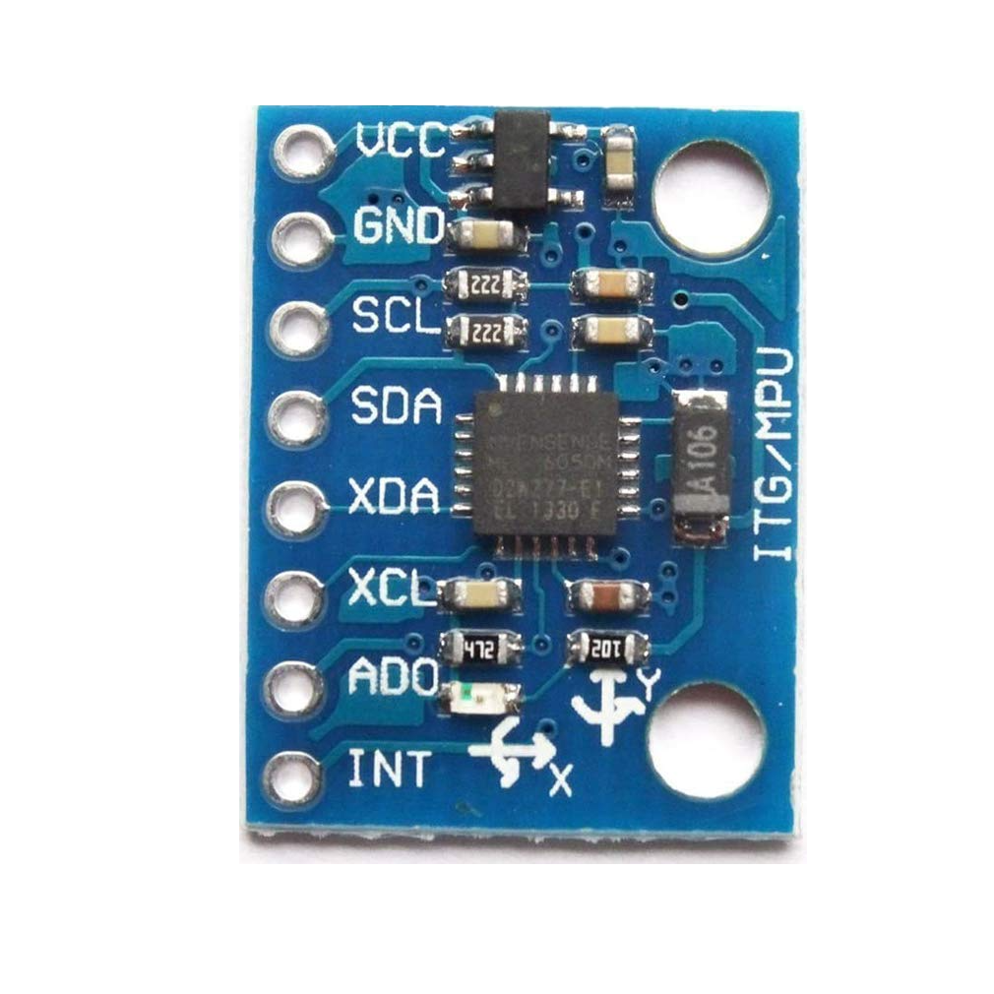
Accelerometers
We will also need an accelerometer to be used in combination with the GPS module.
This particular model - the HiLetgo MPU-6050 also serves as a gyroscope.
This module will be used in combination with the GPS modules on the servo arm.
It will give the servo arm an idea of where the arm is “tilted” in space, and will assist with the alignment and leveling process.
Notes:
-Dawson
Gives an idea of where you are “tilted” in space, you can calibrate it to a certain level. Maybe just a gyroscope

Slide 19
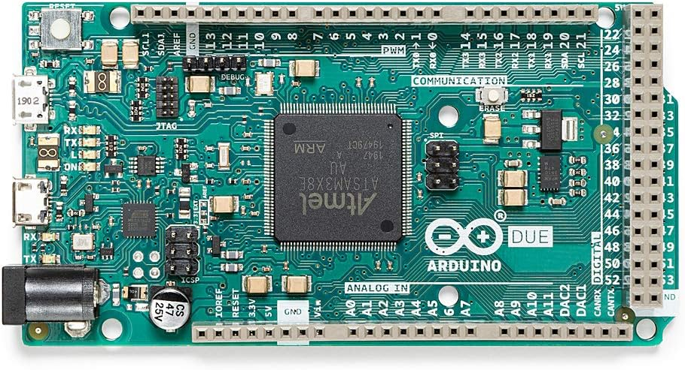
Arduino Boards
This was the projects most recently used board. But we may not be using it.
Some of the important specs for this project:
It's a 32 bit ARM core microcontroller
Contains 54 Digital Input/Output pins
Has an operational voltage of 3.3v
Does not support wifi
We have been having some connection issues with the current one we have.
May replace it with another UNO Wifi for board communication.
We have been working with JP on a solution.

Slide 20
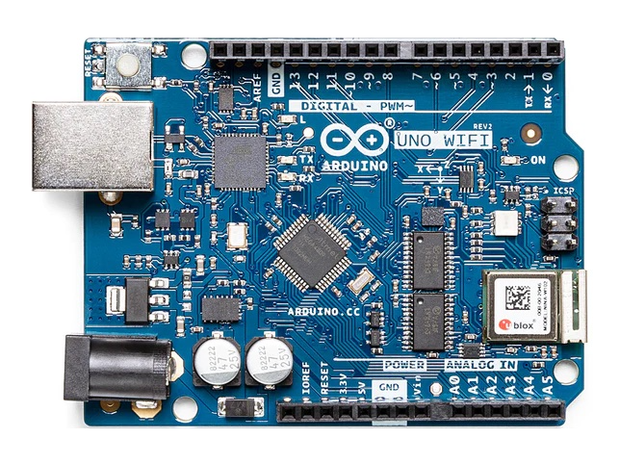
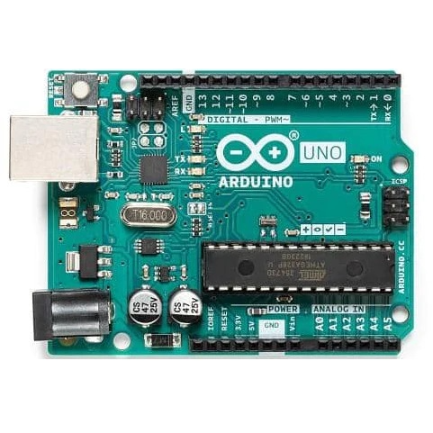
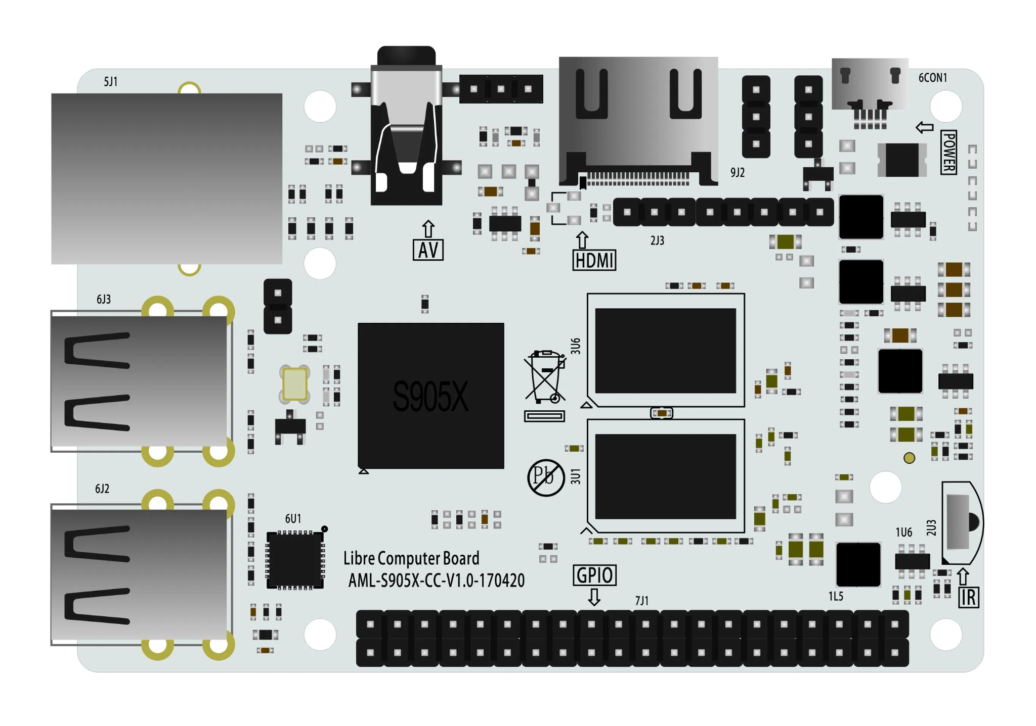
Other Boards and Controllers
For this project we also have access to some other boards we may make use of:
Arduino Uno Rev2 (Wifi)
Arduino Uno (Regular)
Libre Computer Board

Slide 21
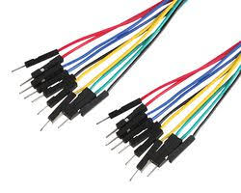
Connections/Other Possible Costs
The last section of our budget is a combination of possible new parts and connectors.
JP has kindly extended the offer to 3D print anything we would need if we can’t ourselves.
So the rest of our budget is split between possible cable/connectors and overhead.
This will likely stay just as overhead, we have an abundance of materials from previous work.

Slide 22
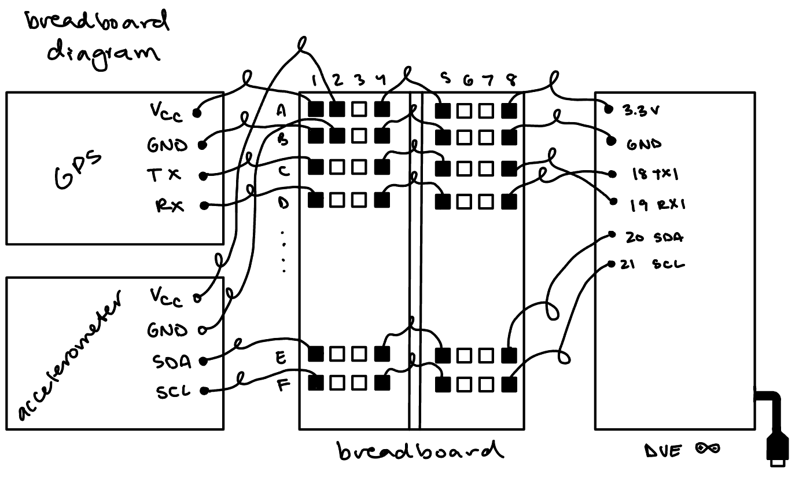
Wiring Diagrams
For GPS and Accelerometer
Using a breadboard

Slide 23
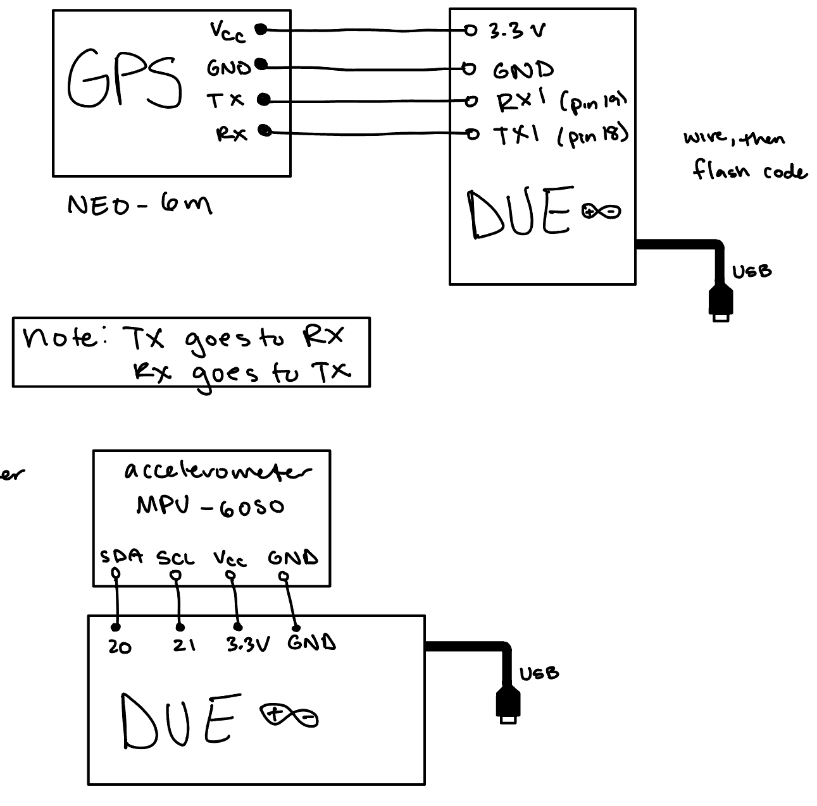
Wiring Diagrams
For GPS and Accelerometer
Directly into an Arduino board

Slide 24

Current Progress on Project
Over the next few slides we will take a look at the progress we’ve made so far on the project.
Notes:
-Dawson

Slide 25
Developed Key Project Documents and Ideas
Created our Project Definition:
Value Proposition
Product Requirement Document (PRD)
Our Project Plan which includes:
Project Schedule
Budget Estimates
Design Validation Plan
Sourced our Concept Design Review:
Final preparations before we undergo the coding process and modifications to the design.
Finishing the final few documents before we undergo the coding process:
Notes:
-Dawson

Slide 26
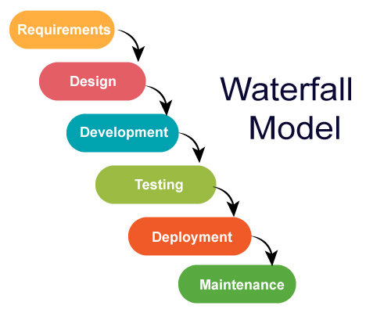
Where are we now?
Currently we just finished examining the previous design and code base. Got it mostly working, still working out some issues.
We have had some issues connecting to our current arduino due setup.
After our concept design review we will start the coding process.
We will be applying the waterfall programming process.
This simply means a sequential approach where each phase finishes before the next starts.
Notes:
-Dawson

Slide 27

Physical Demonstration
Notes:
-All of us, robot does the big lifting (if we can get it to work)

Slide 28

Thank you!
Any questions?
Email:
burg1648@vandals.uidaho.edu

